Slide 1
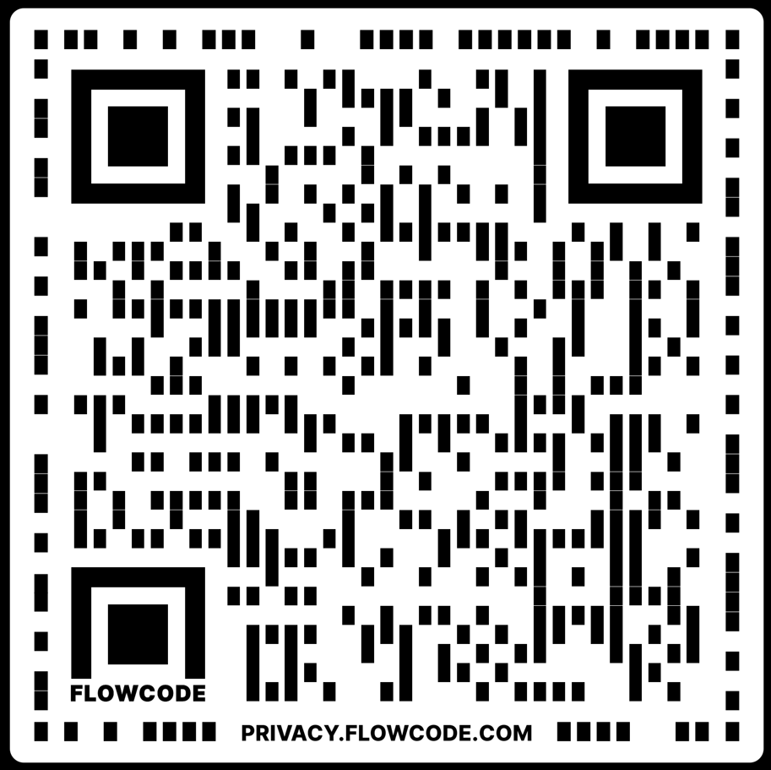
Expanding CTE Programming for rural schools
Lyle Krueger, Assistant Director, Central Regional Area Career & Technical Center

Slide 2
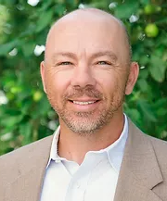
My background
Graduated high school from a VERY small rural community in south central North Dakota; 7 people in my graduating class
High School Math Teacher talked me into going into education
High School history teacher, coach, athletic director
High School principal; expanded HS Ag and Business programs, started IT and Electronics programs
Worked at the Regional Education Association based in Bismarck in various roles for 9yrs
CRACTC Assistant Director for past six years

Slide 3
ND Virtual Centers
One of five North Dakota Department of Career & Technical Education State Board approved virtual centers
Cass County – Fargo
Central Regional Area Career and Technical Center - Bismarck
Grand Forks Area Career and Technical Center – Grand Forks
Great Northwest Area Career and Technical Center – Williston
Roughrider Area Career and Technical Center - Dickinson

Slide 4
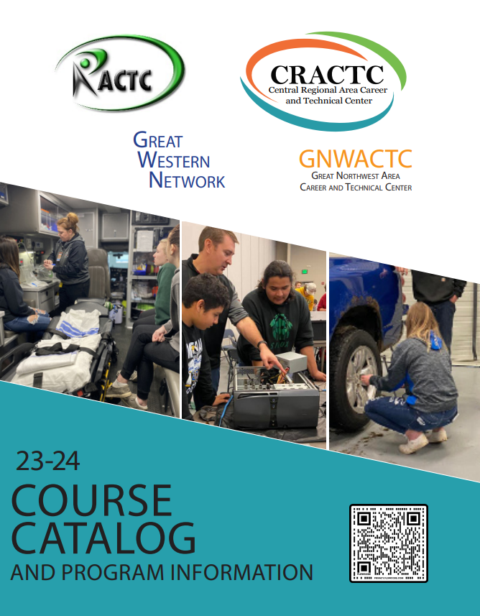
Central Regional Area Career & Technical Center (CRACTC)
CRACTC is a collaborative entity between Bismarck Public Schools and the Central Regional Education Association (CREA)
Provide online/hybrid CTE programming to students who do not have those opportunities at the local level; we do not want to compete with local school programs or other area brick & mortar CTE centers
Collaborate with other virtual and brick & mortar CTE centers for quality and efficiency purposes
Marketing
PowerSchool (grading system)
Registrations
Hands-on learning days

Slide 5
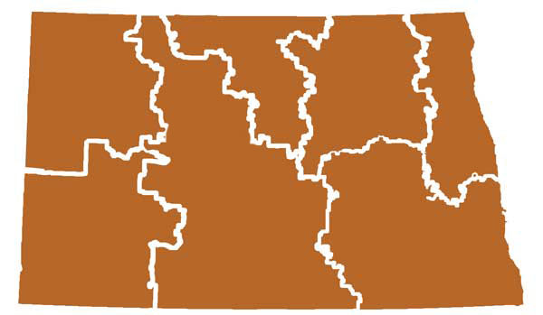
Who do we serve?
Students grades 9-12; 43 member school districts throughout central North Dakota with 49 public high schools and five parochial schools; 22-23SY we are serving students at 56 different high schools throughout the state; provide middle school awareness events to help generate interest in CTE
Member schools range in size from less than 40 students in grades K-12 to over13,500 K-12(BPS)

Slide 6
Enrollment Data
 | Students | Fall Sem | Spring Sem | Yearlong | Total
2022-2023 | 632 | 327 | 279 | 194 | 800
Number of Students (2022-2023) | Number of CRACTC Courses Enrolled
490 | 1 Course (yearlong or semester)
122 | 2 courses (yearlong or semester)
14 | 3 courses (yearlong or semester)
6 | 4 courses (yearlong or semester)

Slide 7
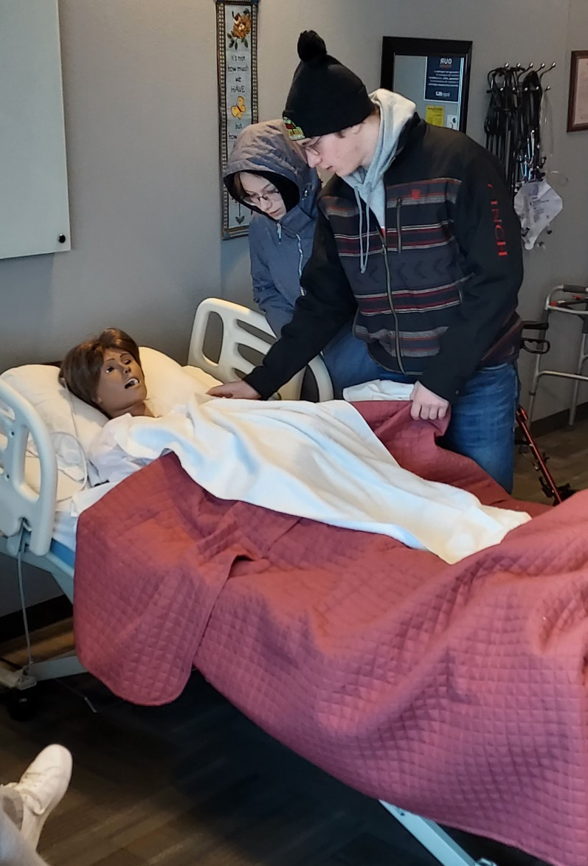
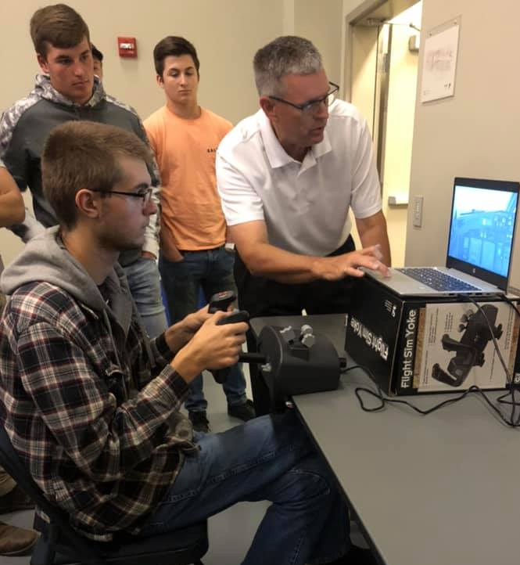
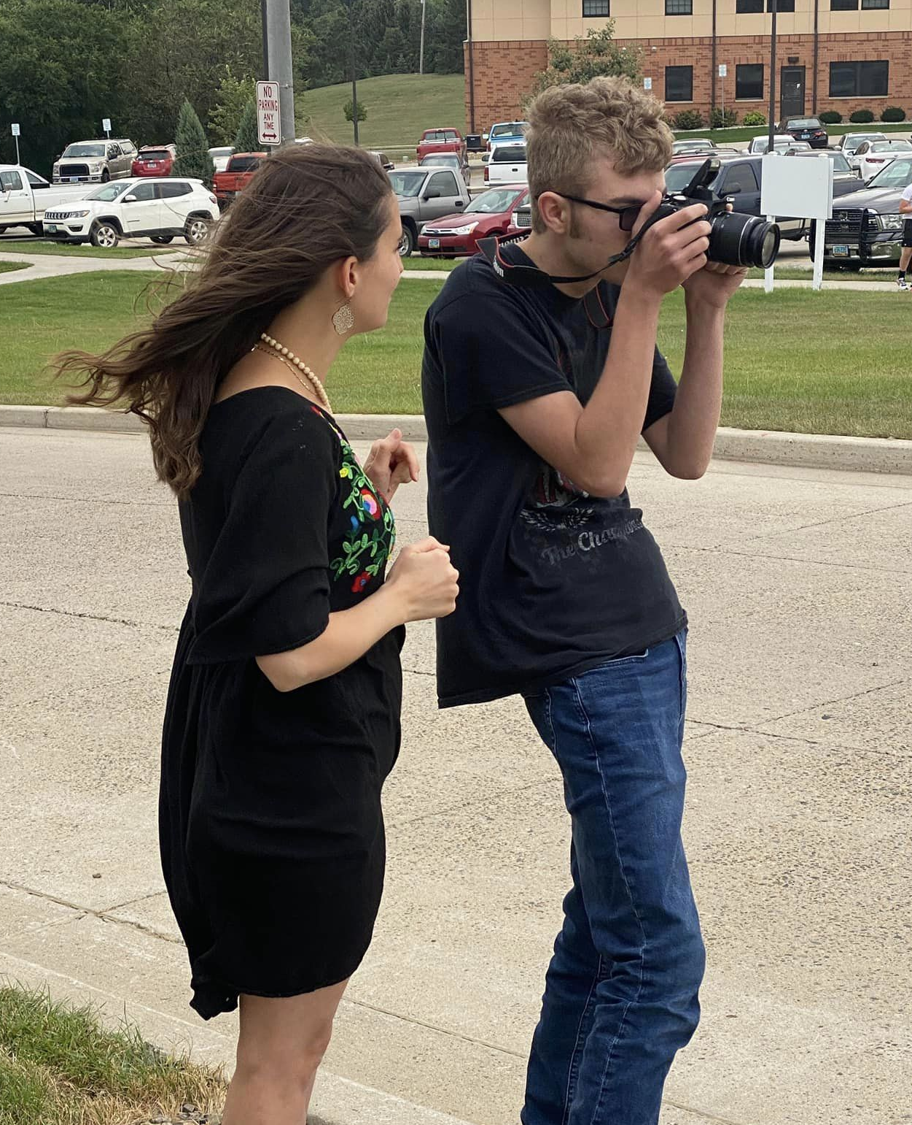
Program Areas
Agriculture
Aviation
Family & Consumer Sciences
Graphic Arts/Photography
Health Sciences
Information Technology
Marketing
Tech & Engineering
Working on expanding into Transportation for CDL, as well as Law & Public Safety

Slide 8
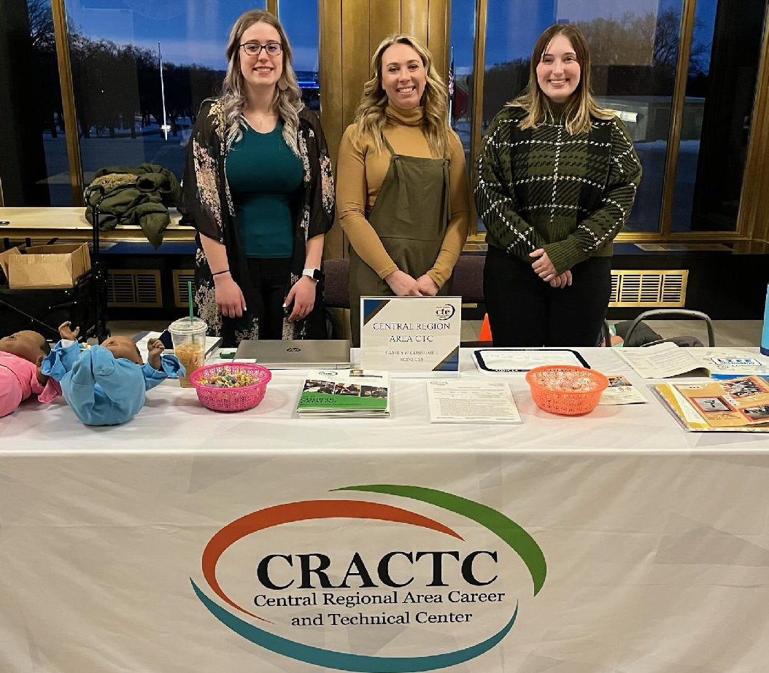
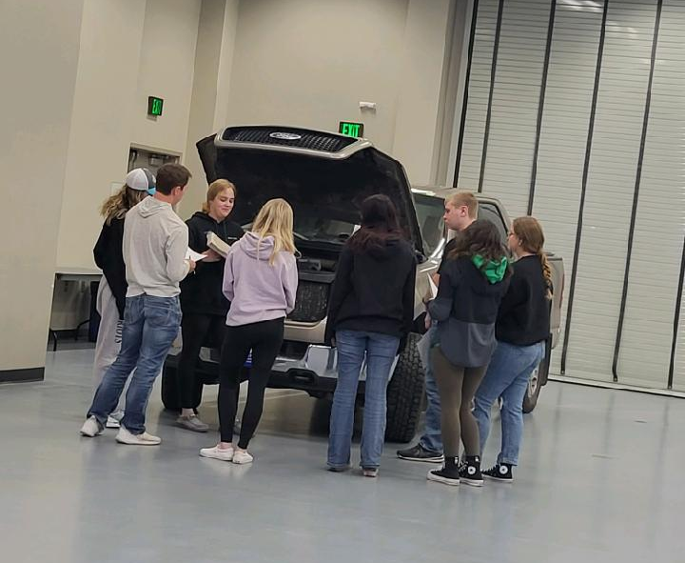
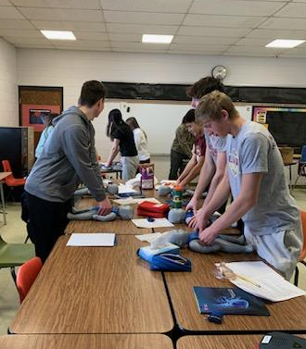
Teachers and Staff
18 total employees (PT and FT); work with Bismarck Public Schools and other schools/CTE Centers
12 teachers; 5.7FTEs
Director
FT Assistant Director
PT Registrar/Marketing
PT Admin Assistant
2 - PT Mobile Lab Coordinators
Work with other CTE centers for hands-on day teachers

Slide 9
Local Facilitators (i.e. Angels)
The adult at each local school that is the conduit between our teachers & admin and the local students & admin
We provide up to $1,200 per year to each school who requests need for this role; must have at least one enrollment

Slide 10
Online Curriculum
Main Learning Management System (LMS) we use is Moodle; depending on teachers comfort level and/or needs, also utilize Google Classroom, Canvas, or Blackboard
We also offer courses and/or work with other virtual CTE centers to provide courses via Interactive Television (ITV)
We offer dual credit for various Health Science and Information Technology Courses through Bismarck State College; working on expanding into Transportation with CDL
All courses follow ND State Standards for their applicable program area and courses
Usually purchase a vendor curriculum as our base content and add to it to make it more engaging and/or meet applicable standards.
All teachers are CTE certified in their respective field

Slide 11
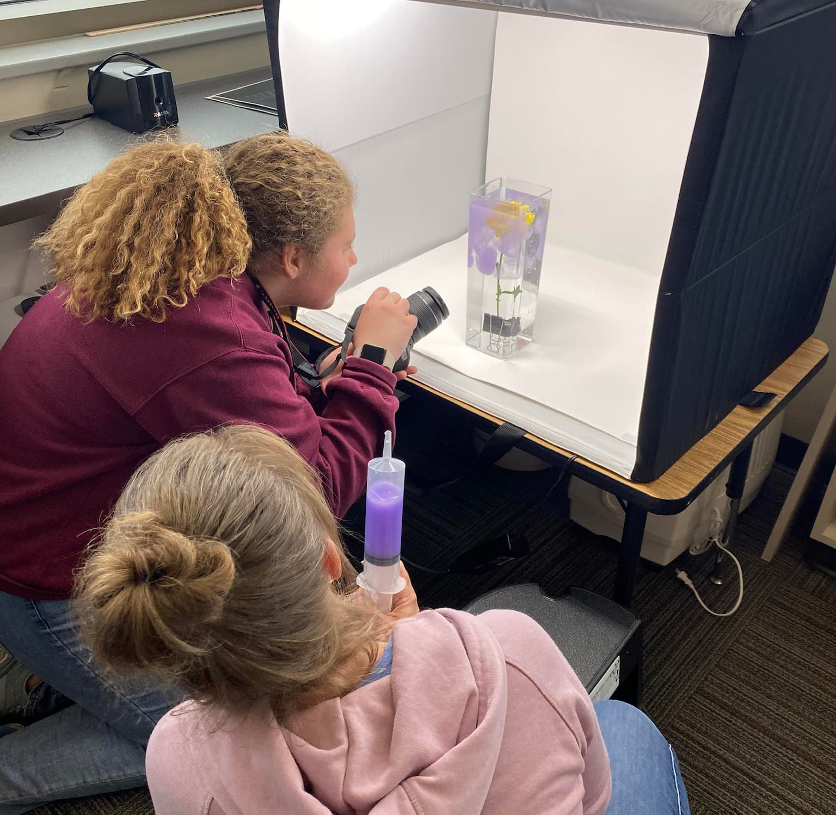
Hands-on Learning
Provide needed equipment/materials to the school sites for applicable class and/or hold Hands-on learning days that are the face-to-face lab application days to enhance students understanding and experiences of the online content.
Each course has a minimum of one hands-on learning day per semester; depending on course, may have up to five within a semester
Schools bring their applicable students to a central location
Reimburse schools for mileage per state rate
Equipment examples: Aviation simulators and demo flights; Cameras and laptops, RealCare Babies delivered to schools; STEM materials; etc.

Slide 12
Career Ready Practices
Students are assessed throughout the semester, including hands-on learning days, on the following:
Responsible Citizen (i.e. Responsibility, Time Management, etc.)
Communication (i.e. Communicating well, asking for assistance when needed, etc.)
Problem Solving (i.e. learning from mistakes, perseverance: attempting to solve issues without immediately giving up, etc.)
Technical Skills (i.e. Using resources to complete work or resolve issues, reading/interpreting, etc.)
Teamwork (i.e. participating in hands-on learning, engaging actively and positively with others, etc.)
Reports are printed and mailed to each participating school for each student to send home with their local report cards

Slide 13
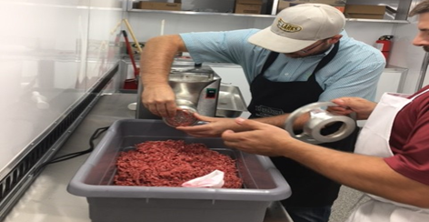
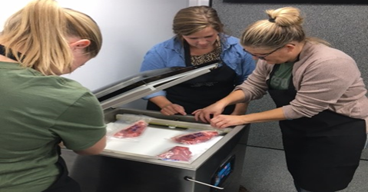
Mobile Lab Programming
Mobile Meats Lab
To enhance local Ag or FCS programs at member schools
Custom Exempt Mobile Meats Processing Labs approved by the ND Dept of Agriculture
Inspected 4+ x per year
Required teacher training prior to use
Six weeks per school
Community donations, grants, and school shared cost model for remaining expenses

Slide 14
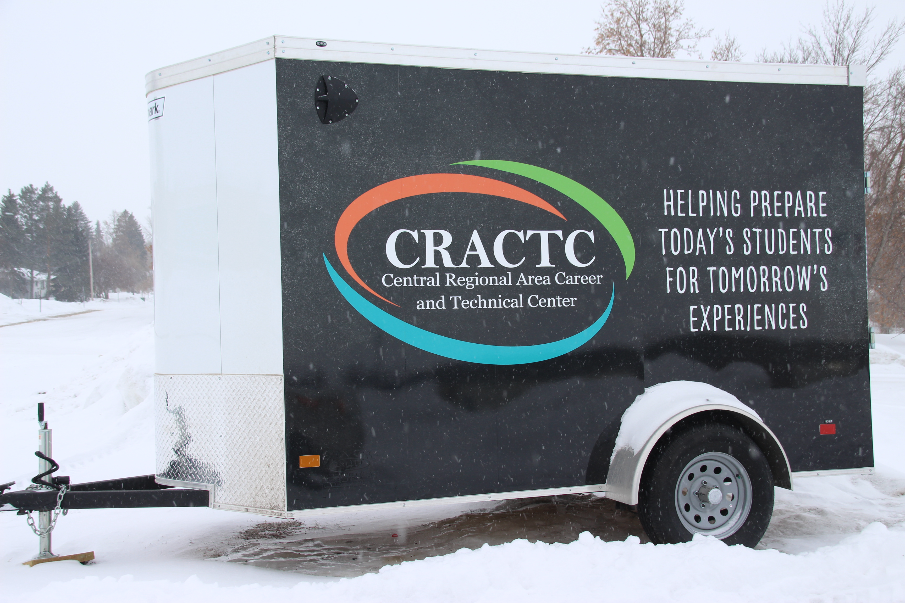
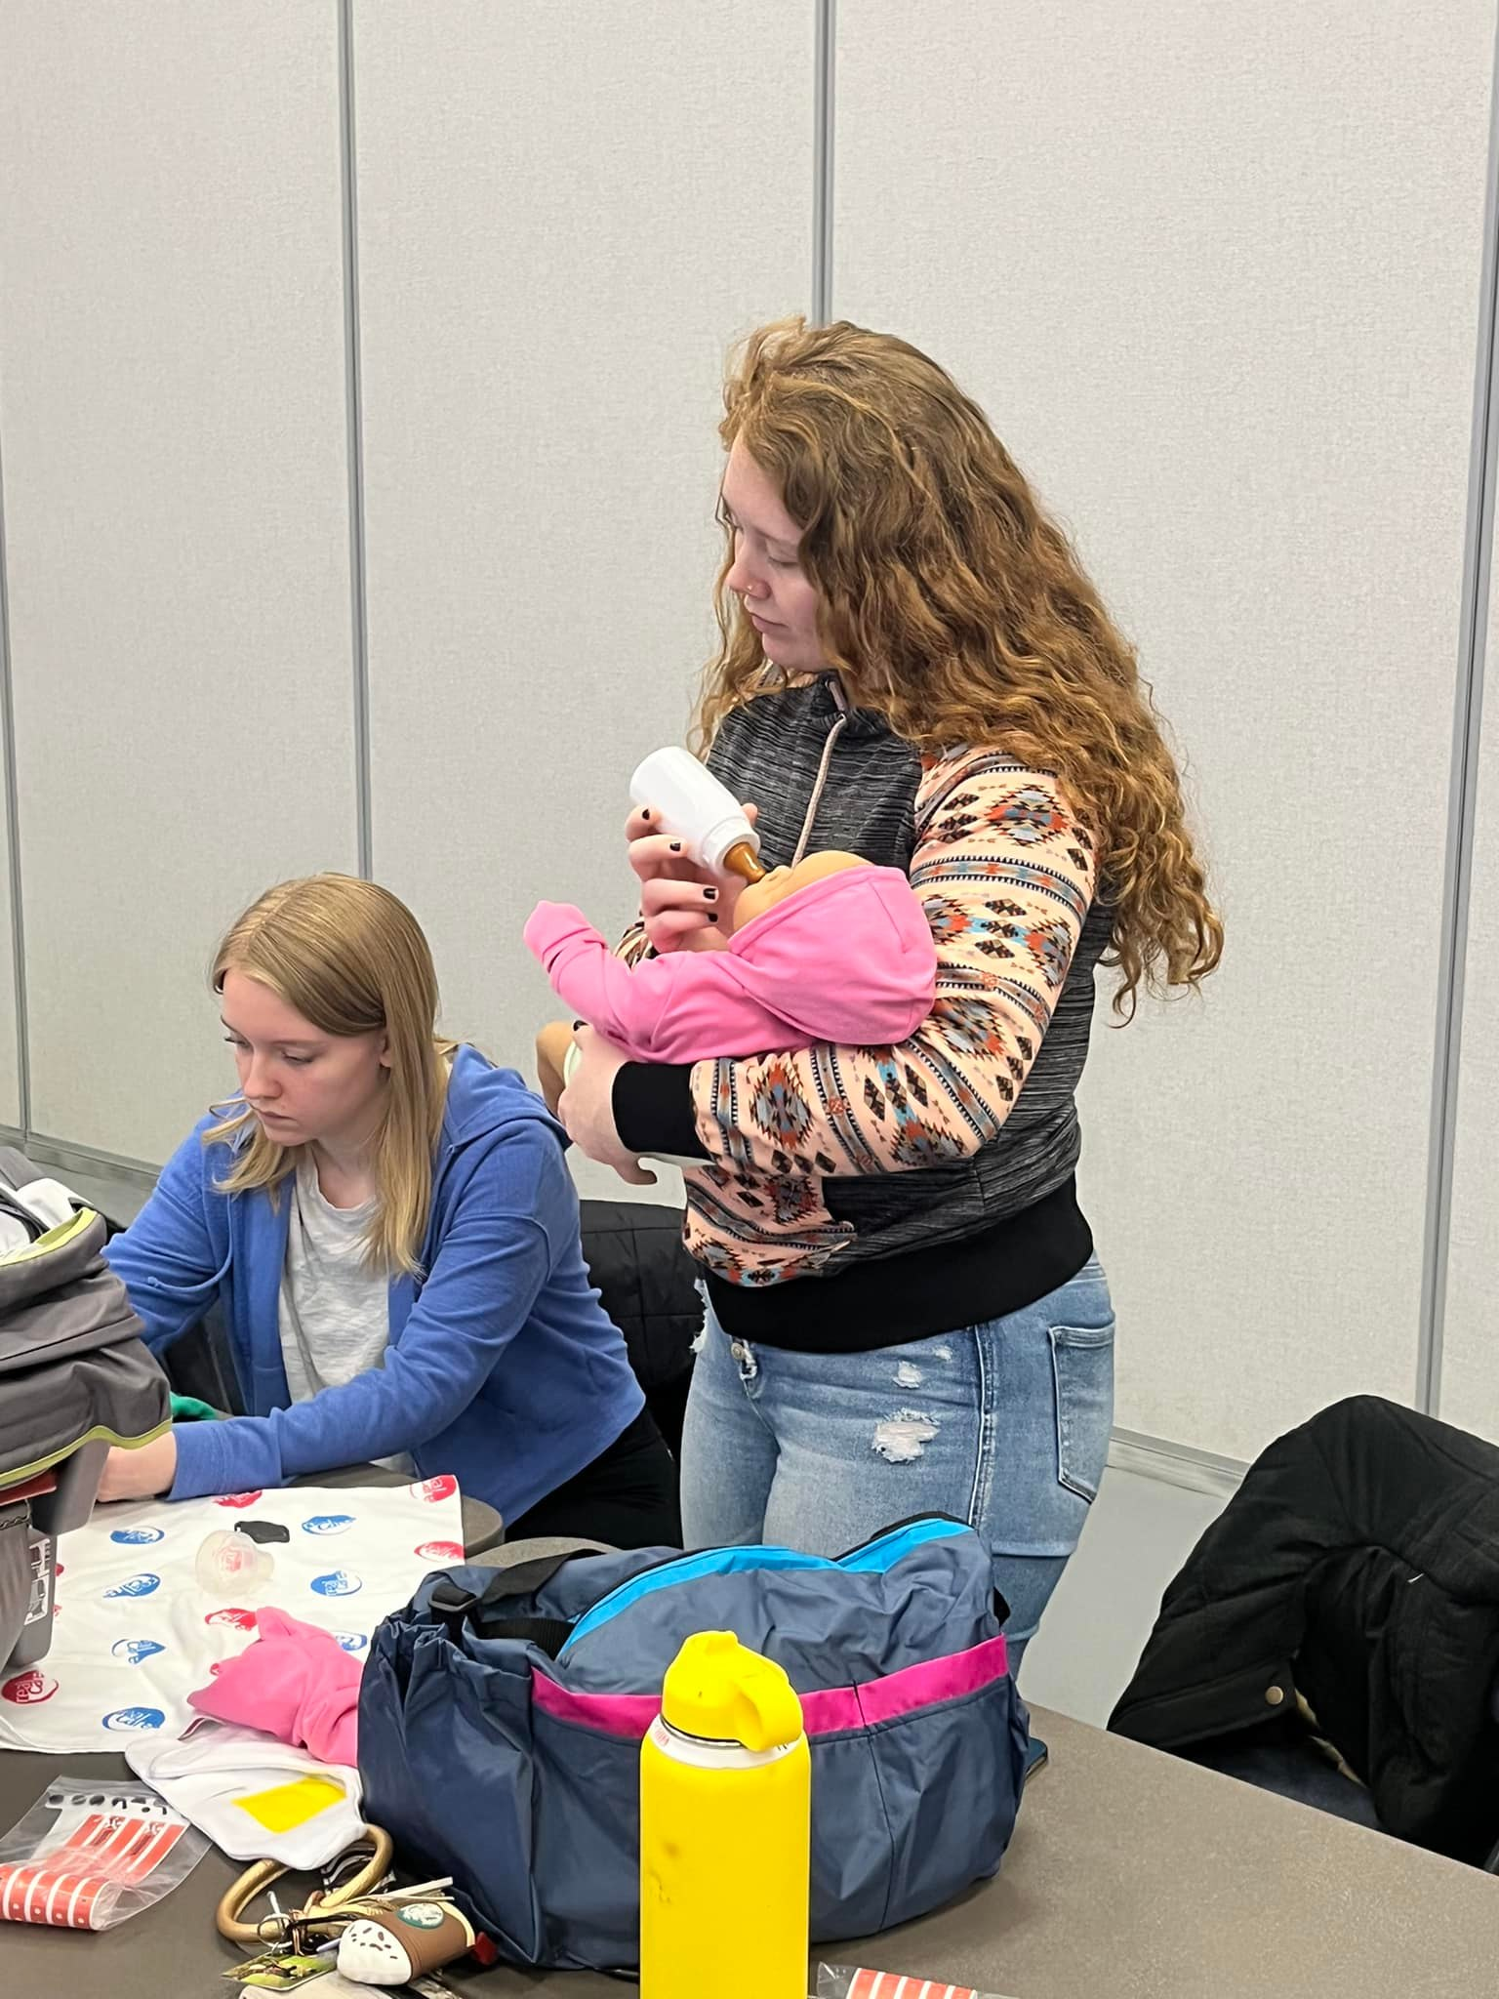
Mobile Lab Programming – Cont.
Mobile Parenting
To enhance FCS programs at local member schools; not through our online/hybrid courses
Focus on fetal development, birth stages, infant CPR & choking, and infant care
5 regular RealCare babies, 2 Fetal Alcohol Syndrome babies, 2 Drug addicted babies, 2 Shaken care babies, 1 CPR infant, 1 choking infant
2 empathy bellies
Equipment is transported to seven schools (up to 8) per school year for 4 weeks each
Community donations, grants, and school shared cost model for remaining expenses

Slide 15
Program Funding
Overall about a $1.2m annual budget; we do not receive Perkins dollars; we are eligible for grant dollars through State CTE Dept
Receive reimbursement from the ND State CTE Dept; 40% base with 4% for each participating school in a program area for salary/benefits/travel/supplemental
Membership fees: $2,000/yr per district
Course enrollment fees: $250/course per semester per student
Mobile Labs: Community partnership donations, grants, district cost shared remaining expenses

Slide 16
Comments from students and schools
“Our teacher is so awesome; she is so personable. She is very organized and easy to get ahold of. Hands-on learning days were really good as we got to do the things we are learning online. We also got to meet and interact with other students from other schools interested in possible medical careers.” -Medical Careers I student, Flasher High School
“I enrolled in the CRACTC Independent Living class to help me qualify for the State CTE Scholarship. I like the information in the class as I get ready for college and won’t be around my family; it is helping me prepare for that. I really enjoy my teacher as I’ve had other classes with her in the past. She communicates with me really quickly when I have questions. I also really like the hands-on days that we have too.” -Independent Living student, Minot Bishop Ryan High School
“The opportunities that are provided for students through the CRACTC are so valuable. We have about 100 student enrollments per semester taking classes through CRACTC that they normally would not be able to take otherwise. The programming that is provided has given my students the ability to take classes in almost every career cluster, which has greatly impacted how many of our students receive the North Dakota Academic or CTE scholarships. Students love the hands-on, applicable, real-world content! The classes through the CRACTC have provided students with foundational knowledge in future careers, and many of these classes have solidified their career choices.” -Counselor, St Mary’s High School

Slide 17
Comments Cont.
“I think I have taken every IT class provided through CRACTC and have enjoyed them all. I was able to learn that I enjoy coding more than networking within the IT field and plan to go to college for IT to hopefully become an Coding engineer someday and the information I am learning through their classes has helped me a lot. I think that these classes have given me a leg up on my future plans and I wouldn’t have been able to do it without the CRACTC classes and Mr. Horner.” -IT student, Grant County High School
“The staff at the Central Regional Area Career and Technical Center (CRACTC) have been great to work with and are easily accessible. Lyle Krueger makes sure to keep us informed regularly with new class offerings, class openings for students, and upcoming hands-on days for the students. The teachers respond to emails in a timely manner so I always feel like I am in the loop and am rarely caught off-guard when a student is struggling. The curriculum is vast and relevant and provides my students with opportunities they would not have otherwise. We have had a number of students enter the field of computer programming who may not have done that without the help of the CRACTC. The CRACTC staff is also looking for new career fields and areas that may be of interest to students such as Cybersecurity and Video Game Design. I am grateful for the opportunities the CRACTC provides my students and the diligent way in which they do it.” -Monty Mayer, HS Principal, Hazen

Slide 18
Contact Information
Please feel free to contact me if you have any questions!
Email at lyle.krueger@k12.nd.us; work #: 701-415-0453
Website: cractc.org
Social Media: Central Regional Area Career and Technical Center on Facebook and Twitter

